Slide 1
Lexical Analysis
CSE 420
Lecture 02

Slide 2
Lexical Analysis
Basic Concepts & Regular Expressions
What does a Lexical Analyzer do?
How does it Work?
Formalizing Token Definition & Recognition
Reviewing Finite Automata Concepts
Non-Deterministic and Deterministic FA
Conversion Process
Regular Expressions to NFA
NFA to DFA
Relating NFAs/DFAs /Conversion to Lexical Analysis

Slide 3
Lexical Analyzer in Perspective
token
source program
lexical analyzer
parser
get next token
symbol table
Important Issue:
What are Responsibilities of each Box ?
Focus on Lexical Analyzer and Parser.

Slide 4
Lexical Analyzer in Perspective
LEXICAL ANALYZER
Scan Input
Remove WS, NL, …
Identify Tokens
Create Symbol Table
Insert Tokens into ST
Generate Errors
Send Tokens to Parser
PARSER
Perform Syntax Analysis
Actions Dictated by Token Order
Update Symbol Table Entries
Create Abstract Rep. of Source
Generate Errors
And More…. (We’ll see later)

Slide 5
What Factors Have Influenced the Functional Division of Labor ?
Separation of Lexical Analysis From Parsing Presents a Simpler Conceptual Model
A parser embodying the conventions for comments and white space is significantly more complex that one that can assume comments and white space have already been removed by lexical analyzer.
Separation Increases Compiler Efficiency
Specialized buffering techniques for reading input characters and processing tokens…
Input device-specific anomalies can be restricted to the lexical analyzer.

Slide 6
Introducing Basic Terminology
What are Major Terms for Lexical Analysis?
TOKEN
A pair consisting of a token name and an optional attribute value.
A particular keyword, or a sequence of input characters denoting identifier.
PATTERN
A description of a form that the lexemes of a token may take.
For keywords, the pattern is just a sequence of characters that form keywords.
LEXEME
Actual sequence of characters that matches pattern and is classified by a token

Slide 7
Introducing Basic Terminology
Token
Sample Lexemes
Informal Description of Pattern
const
if
relation
id
num
literal
const
if
<, <=, =, < >, >, >=
pi, count, D2
3.1416, 0, 6.02E23
“core dumped”
const
characters of i, f
< or <= or = or < > or >= or >
letter followed by letters and digits
any numeric constant
any characters between “ and “ except “
Info is
1. Stored in symbol table
2. Pointer is returned to parser
Classifies Pattern

Slide 8
Attributes for Tokens
When more than one lexeme can match a pattern, a lexical analyzer must provide the compiler additional information about that lexeme matched.
In formation about identifiers, its lexeme, type and location at which it was first found is kept in symbol table.
The appropriate attribute value for an identifier is a pointer to the symbol table entry for that identifier.

Slide 9
Attributes for Tokens
Tokens influence parsing decision;
The attributes influence the translation of tokens.
Example: E = M * C ** 2
<id, pointer to symbol-table entry for E>
<assign_op, >
<id, pointer to symbol-table entry for M>
<mult_op, >
<id, pointer to symbol-table entry for C>
<exp_op, >
<num, integer value 2>

Slide 10
Handling Lexical Errors
Its hard for lexical analyzer without the aid of other components, that there is a source-code error.
If the statement fi is encountered for the first time in a C program it can not tell whether fi is misspelling of if statement or a undeclared identifier.
Probably the parser in this case will be able to handle this.
Error Handling is very localized, with Respect to Input Source
For example: whil ( x = 0 ) do generates no lexical errors in PASCAL

Slide 11
Handling Lexical Errors
In what Situations do Errors Occur?
Lexical analyzer is unable to proceed because none of the patterns for tokens matches a prefix of remaining input.
Panic mode Recovery
Delete successive characters from the remaining input until the analyzer can find a well-formed token.
May confuse the parser – creating syntax error
Possible error recovery actions:
Deleting or Inserting Input Characters
Replacing or Transposing Characters

Slide 12
Buffer Pairs
Lexical analyzer needs to look ahead one or more characters beyond the lexeme for a pattern before a match can be announced.
Special Buffering Technique
Use a buffer divided into two N-character halves
N = Number of characters on one disk block
One system command read N characters
Fewer than N character => eof

Slide 13
Buffer Pairs (2)
Two pointers lexemebegin and forward to the input buffer are maintained.
The string of characters between the pointers is the current lexeme.
Initially both pointers point to first character of the next lexeme to be found. Forward pointer scans ahead until a match for a pattern is found
Once the next lexeme is determined, the forward pointer is set to the character at its right end.
After the lexeme is processed both pointers are set to the character immediately past the lexeme
E
=
M
*
C
*
*
2
eof
Lexeme_beginning
forward
Comments and white space can be treated as patterns that yield no token

Slide 14
Specification of Tokens
Regular expressions are an important notation for specifying lexeme patterns
An alphabet is a finite set of symbols.
Typical example of symbols are letters, digits and punctuation etc.
The set {0, 1} is the binary alphabet.
A string over an alphabet is a finite sequence of symbols drawn from that alphabet.
The length is string s is denoted as |s|
Empty string is denoted by ε
Prefix: ban, banana, ε, etc are the prefixes of banana
Suffix: nana, banana, ε, etc are suffixes of banana
Kleene or closure of a language L, denoted by L*.
L*: concatenation of L zero or more times
L⁰: concatenation of L zero times
L⁺: concatenation of L one or more times

Slide 15
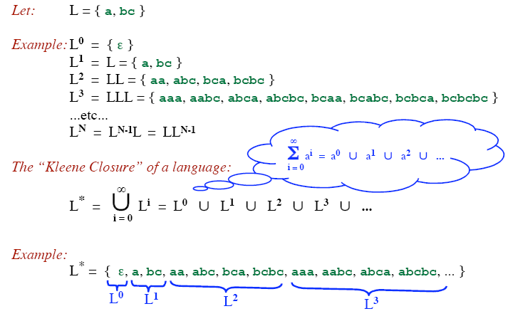
Kleene closure
L* denotes “zero or more concatenations of” L

Slide 16
Example
Let: L = { a, b, c, ..., z }
D = { 0, 1, 2, ..., 9 }
D⁺ = “The set of strings with one or more digits”
L ∪ D = “The set of all letters and digits (alphanumeric characters)”
LD = “The set of strings consisting of a letter followed by a digit”
L* = “The set of all strings of letters, including ε, the empty string”
( L ∪ D )* = “Sequences of zero or more letters and digits”
L ( ( L ∪ D )* ) = “Set of strings that start with a letter, followed by zero or more letters and digits.”

Slide 17
Rules for specifying Regular Expressions
Regular expressions over alphabet ∑
ε is a regular expression that denotes {ε}.
If a is a symbol (i.e., if a∈ ∑), then a is a regular expression that denotes {a}.
Suppose r and s are regular expressions denoting the languages L(r) and L(s). Then
(r) | (s) is a regular expression denoting L(r) U L(s).
(r)(s) is a regular expression denoting L(r)L(s).
(r)* is a regular expression denoting (L(r))*.
(r) is a regular expression denoting L(r).

Slide 18
How to “Parse” Regular Expressions
Precedence:
* has highest precedence.
Concatenation as middle precedence.
| has lowest precedence.
Use parentheses to override these rules.
Examples:
a b* = a (b*)
If you want (a b)* you must use parentheses.
a | b c = a | (b c)
If you want (a | b) c you must use parentheses.
Concatenation and | are associative.
(a b) c = a (b c) = a b c
(a | b) | c = a | (b | c) = a | b | c
Example:
b d | e f * | g a = (b d) | (e (f *)) | (g a)

Slide 19
Example
Let Σ = {a, b}
The regular expression a | b denotes the set {a, b}
The regular expression (a|b)(a|b) denotes {aa, ab, ba, bb}
The regular expression a* denotes the set of all strings of zero or more a’s. i.e., {ε, a, aa, aaa, ….. }
The regular expression (a|b)* denotes the set containing zero or more instances of an a or b.
The regular expression a|a*b denotes the set containing the string a and all strings consisting of zero or more a’s followed by one b.

Slide 20
Regular Definition
If Σ is an alphabet of basic symbols then a regular definition is a sequence of the following form:
d₁→r₁
d₂→r₂
……..
d_{n}→r_{n}
where
Each d_{i} is a new symbol such that d_{i} ∉ Σ and d_{i} ≠d_{j} where j < I
Each r_{i} is a regular expression over Σ ∪ {d₁,d₂,…,d_{i-1})

Slide 21
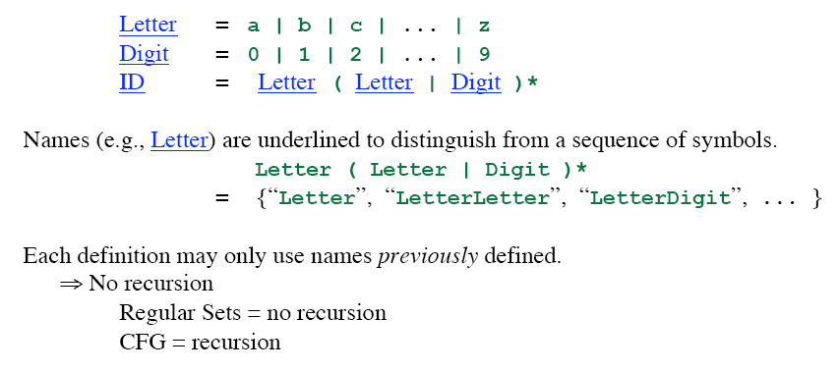
Regular Definition

Slide 22
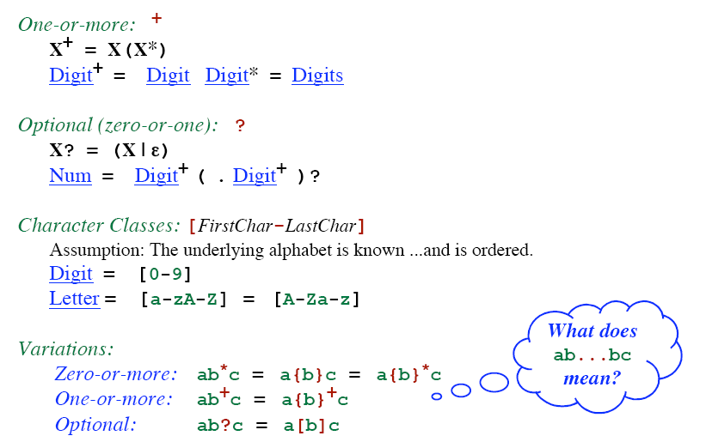
Addition Notation / Shorthand

Slide 23
Unsigned Number
1240, 39.45, 6.33E15, or 1.578E-41
digit → 0 | 1 | 2 | … | 9
digits → digit digit*
optional_fraction → . digits | ∈
optional_exponent → ( E ( + | -| ∈) digits) | ∈
num → digits optional_fraction optional_exponent
Shorthand
digit → 0 | 1 | 2 | … | 9
digits → digit⁺
optional_fraction → (. digits ) ?
optional_exponent → ( E ( + | -) ? digits) ?
num → digits optional_fraction optional_exponent

Slide 24
Some Other Examples
Telephone numbers of the form
(937)-775-5134
exchange = digit³
phone = digit⁴
area = digit³
phone_number = '(' area ')-' exchange '-' phone
Email address
violin@cs.wright.edu
??

Slide 25
Token Recognition
How can we use concepts developed so far to assist in recognizing tokens of a source language ?
Assume Following Tokens:
if, then, else, relop, id, num
Given Tokens, What are Patterns ?
Grammar: stmt → |if expr then stmt |if expr then stmt else stmt |∈ expr → term relop term | term term → id | num
if → if
then → then
else → else
relop → < | <= | > | >= | = | <>
id → letter ( letter | digit )*
num → digit ⁺ (. digit ⁺ ) ? ( E(+ | -) ? digit ⁺ ) ?

Slide 26
What Else Does Lexical Analyzer Do?
Scan away blanks, new lines, tabs
Can we Define Tokens For These?
blank → blank
tab → tab
newline → newline
delim → blank | tab | newline
ws → delim ⁺
In these cases no token is returned to parser

Slide 27
Overall
Regular Expression
Token
Attribute-Value
ws
if
then
else
id
num
<
<=
=
< >
>
>=
-
if
then
else
id
num
relop
relop
relop
relop
relop
relop
-
-
-
-
pointer to table entry
Exact value
LT
LE
EQ
NE
GT
GE

Slide 28
Constructing Transition Diagrams for Tokens
Transition Diagrams (TD) are used to represent the tokens
As characters are read, the relevant TDs are used to attempt to match lexeme to a pattern
Each TD has:
States : Represented by Circles
Actions : Represented by Arrows between states
Start State : Beginning of a pattern (Arrowhead)
Final State(s) : End of pattern (Concentric Circles)
Edges: arrows connecting the states
Each TD is Deterministic (assume) - No need to choose between 2 different actions !

Slide 29
Example : All RELOPs
start
<
=
0
1
2
return(relop, LE)
>
3
return(relop, NE)
other
*
=
4
return(relop, LT)
5
return(relop, EQ)
>
=
6
7
return(relop, GE)
other
*
8
return(relop, GT)

Slide 30
Example TDs : id and delim
id :
letter or digit
start
letter
other
*
9
10
11
return( get_token(), install_id())
Either returns ptr or “0” if reserved
delim :
delim
start
delim
other
*
28
29
30

Slide 31
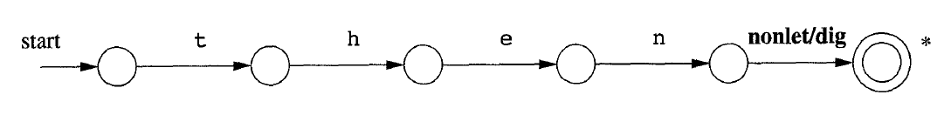
Example TDs : keyword

Slide 32
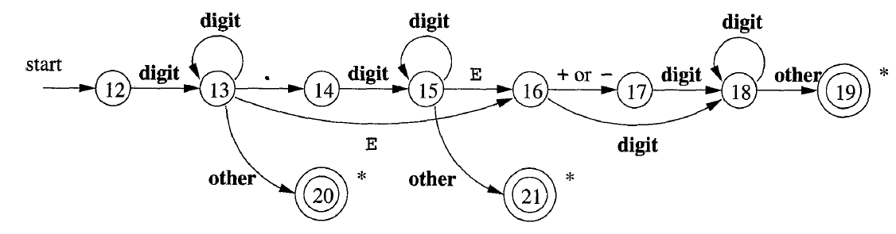
Example TDs : Unsigned #s

Slide 33
Thank You
Any Questions?

